Slide 1

E-Commerce Business Analytics Project
Using Excel, SQL, Python & Power BI

Slide 2

OVERVIEW
Transforming Data Into Business Insights
Data analytics transforms raw information into meaningful insights for modern business decisions.
This project analyzes e-commerce retail data to understand sales performance, customer behavior, and product profitability through an end-to-end analytics workflow.

Slide 3

Project Objectives
Sales & Profit
Regional Insights
Customer Behavior
Interactive Dashboard
Analyze overall performance metrics
Identify high-performing regions and categories
Understand purchasing patterns
Build decision support tools

Slide 4




Analytics Technology Stack
Excel
MySQL
Python
Power BI
Data cleaning & preprocessing
Database creation & querying
Data analysis & visualization
Interactive dashboard development

Slide 5

Industry-Standard Analytics Pipeline
Excel Cleaning
SQL Storage
Python Analysis
Power BI
This workflow represents the complete data journey from raw information to actionable business intelligence.

Slide 6

STEP 1
Data Cleaning Using Excel
Data Preparation Tasks
Removed duplicate records
Handled missing values
Standardized column names
Corrected date formats
Created new columns: Year, Month, Profit Margin

Slide 7
STEP 2
Database Creation Using SQL
MySQL Implementation
Sample Queries
Structured querying for efficient analysis
-- Total sales
SELECT ROUND(SUM(Sales),3)
FROM orders_superstore
-- Sales by Region
SELECT Region, ROUND(SUM(Sales),3)
FROM orders_superstore
GROUP BY Region
-- Top performing products
SELECT TOP 5 Sub_Category,
ROUND(SUM(Profit),3)
FROM orders_superstore
GROUP BY Sub_Category
ORDER BY Total_Profit DESC
Created database
Designed sales table
Imported CSV dataset
Verified data loading

Slide 8
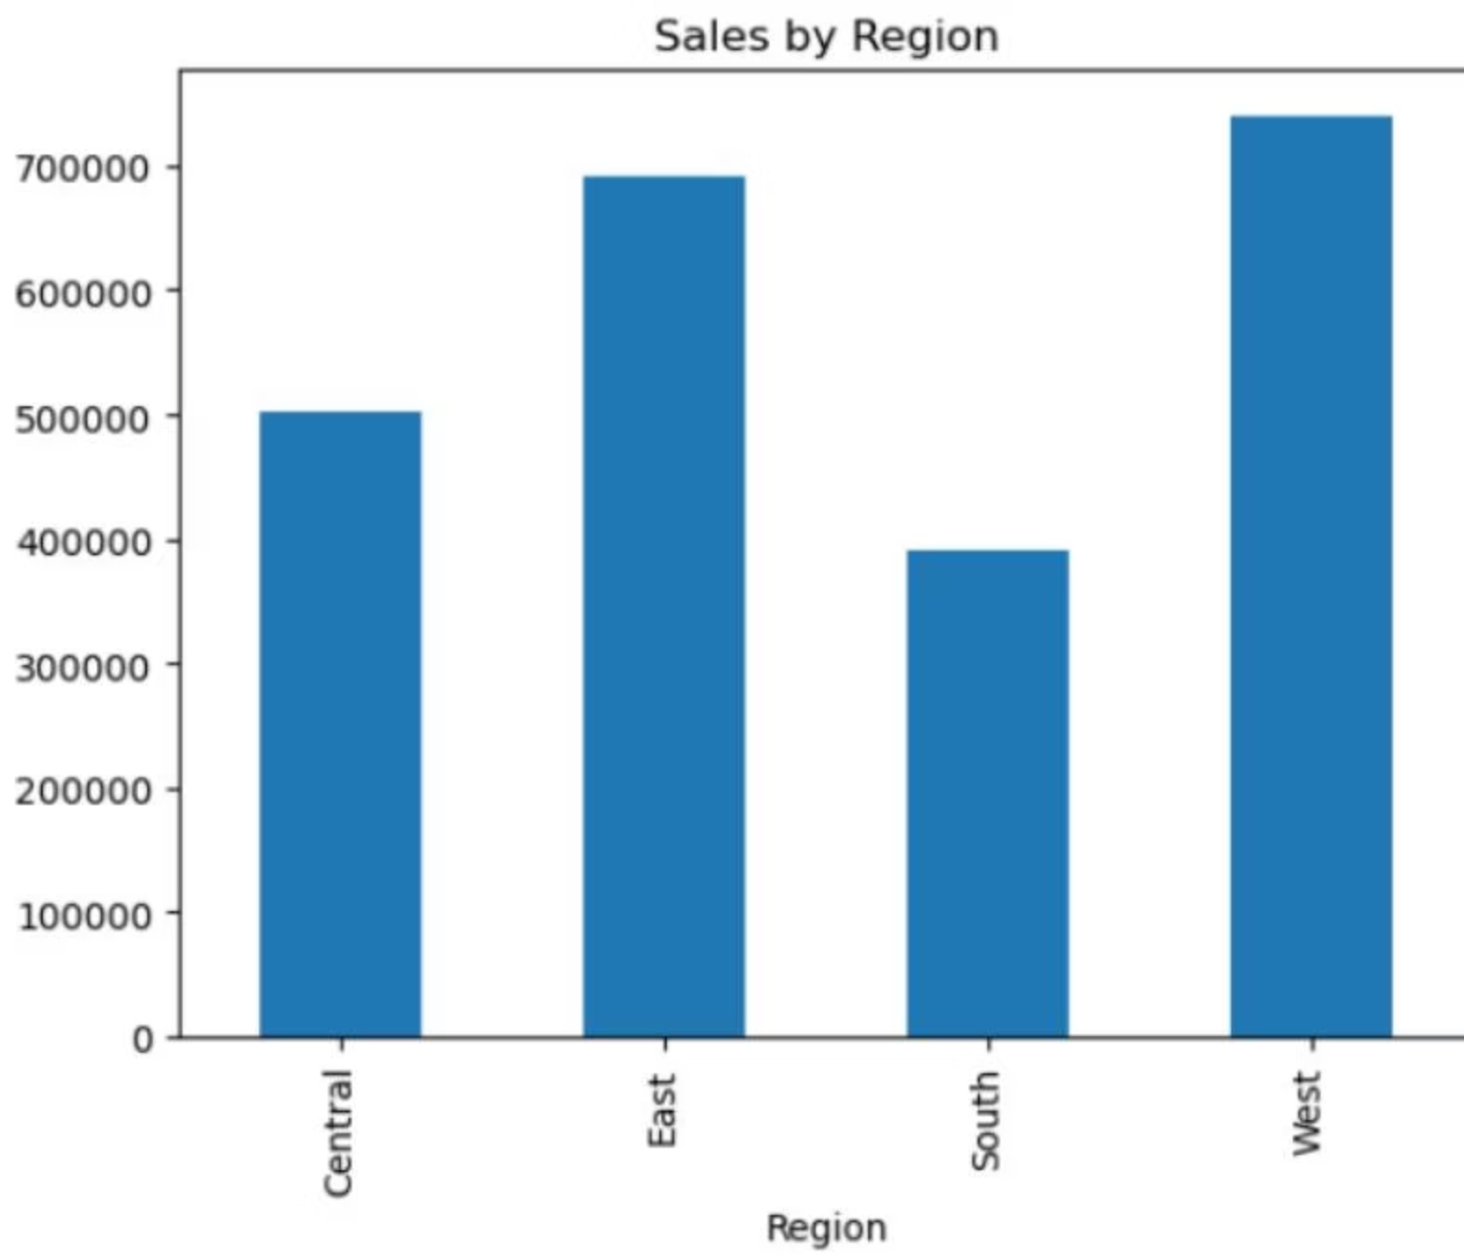
STEP 3
Data Analysis Using Python
Python Libraries
Pandas • Matplotlib • Seaborn • MySQL Connector
Analysis Performed
Statistical summary
Regional & category sales
Customer behavior patterns
Profit margin calculations
Visual chart generation

Slide 9
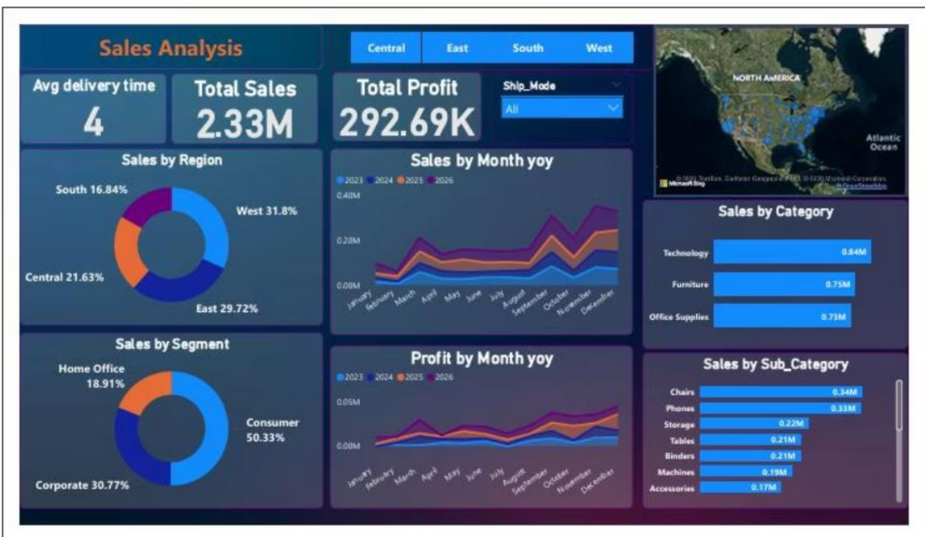
STEP 4
Power BI Dashboard Development
KPI Cards
Trend Analysis
Regional Performance
Category Comparison
Total Sales, Profit, Orders
Sales over time
Geographic insights
Product analysis
Customer Analysis
Interactive Filters
Top buyers
Region, Category, Year

Slide 10
Key Results & Business Impact
$2.33M
$293K
4
Total Sales
Total Profit
Avg Delivery
Overall revenue generated
Net profitability achieved
Days to customer
West Region Dominance
Consumer Segment Leadership
Technology Category Strength
31.8% of total sales, highest performing region
50.33% of sales from consumer purchases
Strong profitability driver with steady growth
This project demonstrates how Python analysis + Power BI dashboards transform raw data into actionable business insights for better decision-making.

